Slide 1
HYBRIDIZING OF MEDIAN IRISES
Featuring Introductions of Carol Lankow

Slide 2
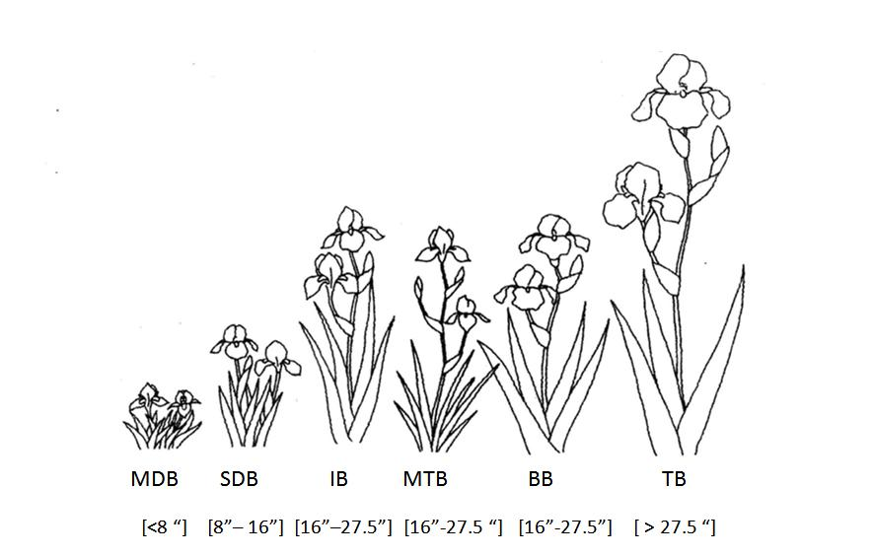
BEARDED IRIS CONFIGURATION

Slide 3
CAROL'S AWARDS BY CLASSES OF IRIS
IRIS TYPE | NO. INTROS | NO. HM’S | NO. AM’S | NO. MEDALS
BB | 11 | 9 | 3 | 1
IB | 12 | 8 | 3 | 2
MDB | 2 | 1 | 1 | 1
MTB | 1 | 1 | 1 | 0
SDB | 19 | 11 | 2 | 0
TB | 4 | 0 | 0 | 0
TOTAL | 49 | 30 | 10 | 4

Slide 4
CAROL LANKOW'S INTRODUCTIONS (BB, IB, MDB)
NO. | VARIETY NAME | INTRO YEAR | TYPE | SEED NO | CHROMOSOME- PARENTS | AWARDS
BC-46 | Sounder | Lankow 1980 | BB | 7578-19 | 48-TB X Iaphylla Geneva S2 | HM
BC-07 | Calico Cat | Lankow 1989 | BB | 7B45-3 | 47-(IB Andi xTB) X BB | Medal
BC-37 | Peach Ice Cream | Lankow 1993 | BB | 7H106 | 47-IB-Marmalade Skies X TB | HM
BC-02 | Art Quake | Lankow 1994 | BB | 7H108 | 47-(IB Andi x TB) X BB
BC-12 | Cool Treat | Lankow 1994 | BB | 6E+25 | 46-IB Hellcat X TB | HM
BC-45 | Snoopy | Lankow 1996 | BB | 7K45 | 47-TB X 6E25-Cool Treat | HM
BC-19 | Friday Blues | Lankow 1997 | BB | 6L62 | 46-IB Friday Harbor-4A40-5 X TB | HM
BC-23 | Indigo Doll | Lankow 1997 | BB | 7L75 | 47-TB X 6E25-Cool Treat | HM
BC-13 | Cotton Charmer | Lankow 1998 | BB | 7K | 47-Unknown
BC-10 | Classic Navy | Lankow 1999 | BB | 8K51 | 48-TB X TB | AM
BC-32 | Mango Smoothy | Lankow 2000 | BB | 5L41 | 45-(IB-Ask Alma x 42 seed) X BB | AM
BC-01 | Andi | Lankow 1974 | IB | L805-1 | 44- TB X SDB | HM
BC-14 | Country Dee Jay | Lankow 1979 | IB | 7544-1 | 44- Lilliput x Iaphylla Geneva S2 | HM
BC-05 | Briquet | Lankow 1980 | IB | 6622-1 | 44-TB X (TB x Ipumila) | HM
BC-28 | Keri | Lankow 1980 | IB | 7592-2 | 44-TB X SDB
BC-33 | Moss Bay | Lankow 1986 | IB | 4A39-1 | 44-SDB X Iaphylla-Geneva S2 | HM
BC-03 | Ask Alma | Lankow 1987 | IB | 4B-32-7 | 44-TB X SDB | Medal
BC-20 | Friday Harbor | Lankow 1989 | IB | 4A40-5 | 46-SDB X TB | HM
BC-29 | Lady Day | Lankow 1990 | IB | 4C39-3 | 44-SDB X TB
BC-27 | Kara Noelle | Lankow 1991 | IB | 4F50-3 | 44-TB X SDB
BC-08 | Cee Jay | Lankow 1992 | IB | 4G35-1 | 44-TB X SDB | Medal
BC-30 | Lemon Whip | Lankow 1993 | IB | 4H55-1 | 44- TB X SDB | AM
BC-43 | Santas Helper | Lankow 1997 | IB | 4J34 | 44-(TB X(( IB-Cheers x (TB x SDB))
BC-21 | Hey There | Lankow 1992 | MDB | OH1-1 | 36-SDB X MDB | Medal
BC-26 | Jolly Joey | Lankow 1993 | MDB | 0J4-11 | 40-SDB X SDB

Slide 5
CAROL LANKOW'S INTRODUCTIONS (SDB, MTB, TB)
NO. | VARIETY NAME | INTRO YEAR | TYPE | SEED NO | CHROMOSOME- PARENTS | AWARDS
BC-04 | Belle Plaine | Lankow 1984 | SDB | 80-8-1 | 40-SDB X SDB
BC-44 | Sea Worthy | Lankow 1984 | SDB | 80-2-2 | 40-SDB X SDB
BC-40 | Pipe Stone | Lankow 1985 | SDB | 80-10-5 | 40-SDB X SDB
BC-47 | Straw Hat | Lankow 1985 | SDB | 80-11-3 | 40-SDB X SDB | HM
BC-31 | Live Jazz | Lankow 1986 | SDB | 2A24-3 | 42-IB-Spring Bonnet X SDB-L56 | HM
BC-06 | Broad Grin | Lankow 1987 | SDB | 2A25-2 | 42-(IB Appleblossom Pink X SDB) | HM
BC-24 | Jesse Lee | Lankow 1987 | SDB | 0A21-10 | 40-SDB X SDB | HM
BC-22 | Home Port | Lankow 1988 | SDB | 0C5-1 | 40-SDB X SDB
BC-35 | Oh Jay | Lankow 1988 | SDB | 2A30-4 | 42-SDB X (SDB x TB)
BC-36 | Over Easy | Lankow 1990 | SDB | 0F6-25 | 40-SDB X SDB | HM
BC-42 | Rosalie M | Lankow 1990 | SDB | 2F28-5 | 42-(IB-Peachy Face X SDB
BC-49 | Violet Wood | Lankow 1990 | SDB | 0C4-4 | 40-SDB X SDB
BC-34 | Nut Ruffles | Lankow 1992 | SDB | 0H15-1 | 40-SDB X SDB | AM
BC-25 | Jewelers Art | Lankow 1993 | SDB | 0H15-2 | 40-SDB X SDB | AM
BC-41 | Plum Lucky | Lankow 1994 | SDB | 0F4-2 | 40-SDB X SDB | HM
BC-48 | Tickled Peach | Lankow 1994 | SDB | 2H27-1 | 42-IB-Spring Dancer X SDB | HM
BC-09 | China Peach | Lankow 1995 | SDB | 1D24-3 | 41-SDB X 2A25-2-Broad Grin | HM
BC-11 | Condensed Version | Lankow 1999 | SDB | 0L13 | 40-SDB X SBD
BC-38 | Peach Ruffles | Lankow 2000 | SDB | 0L1-C | 40-SDB X SDB | HM
 | Pink Buttons | Lankow 1996 | MTB |  | Ozark Evening X (Abridged Version x Greensleeves) | AM
BC-18 | Dress Blues | Lankow 1986 | TB | 80-20-1 | 48- TB X TB
BC-15 | Dancing Sunspots | Lankow 2001 | TB | 7L78 | 47-TB X ( IB-Marmalade Skies x TB)
BC-16 | Dotted Ditty | Lankow 2001 | TB | 6K16 | 46-IB-Cee Jay X TB
BC-17 | Dream Away | Lankow 2002 | TB | 7J69 | 47-IB -Looking Good X TB

Slide 6
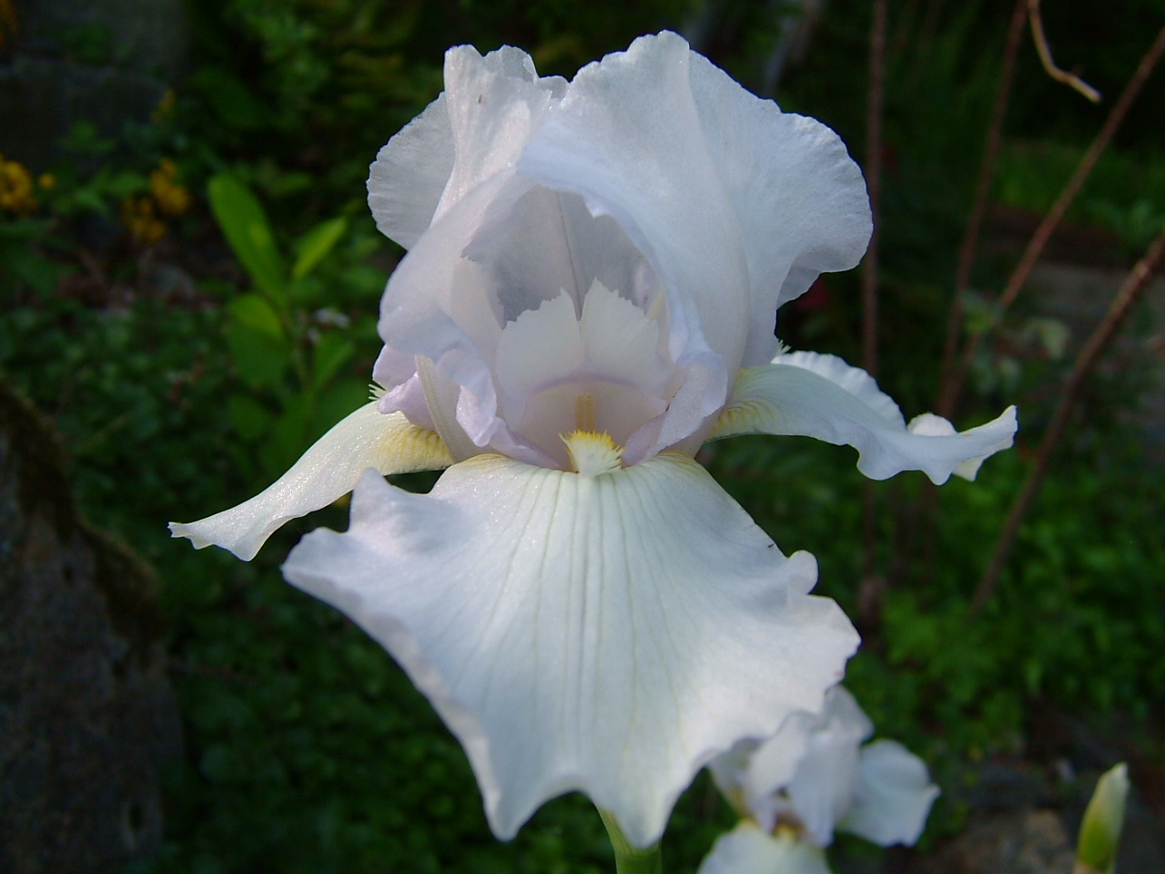
Sounder
1980 | BB | 7578-19 | 48-TB X Iaphylla Geneva S2 | HM

Slide 7
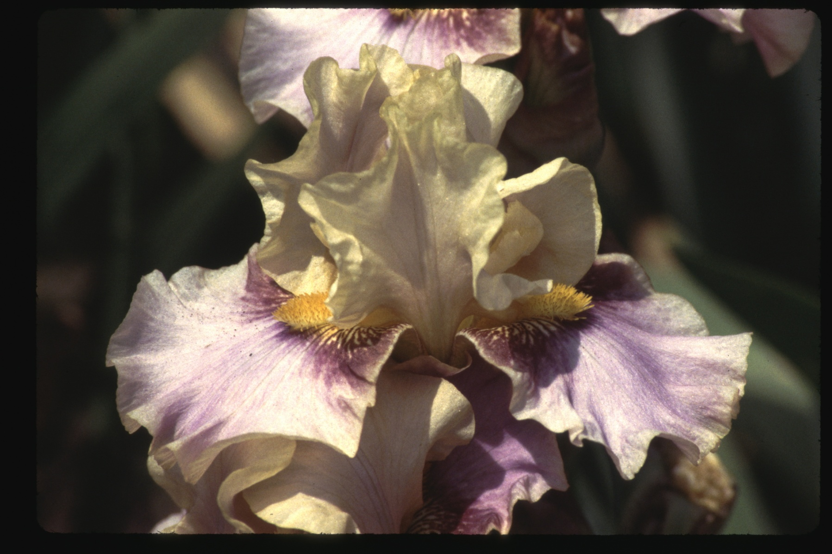
Calico Cat
1989 | BB | 7B45-3 | 47-(IB Andi xTB) X BB | Medal

Slide 8
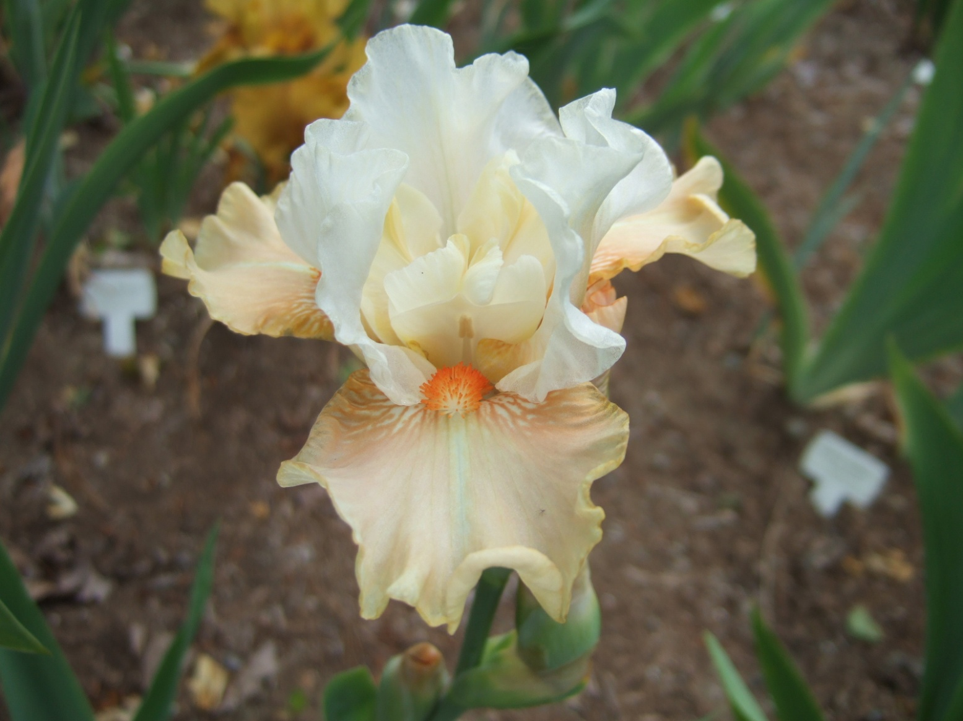
Peach Ice Cream
1993 | BB | 7H106 | 47-IB-Marmalade Skies X TB | HM

Slide 9
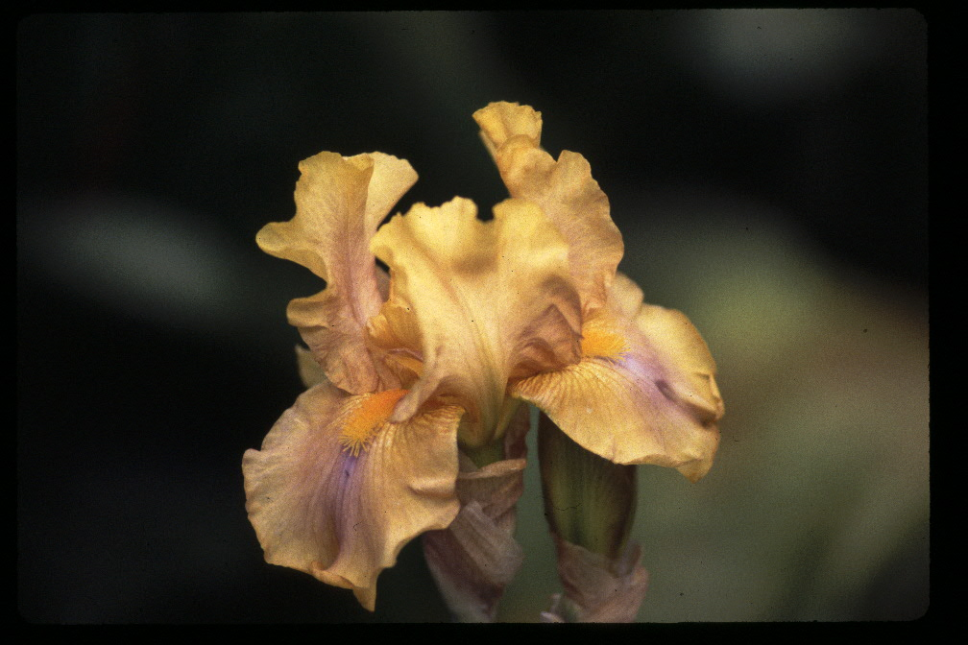
Art Quake
1994 | BB | 7H108 | 47-(IB Andi x TB) X BB

Slide 10
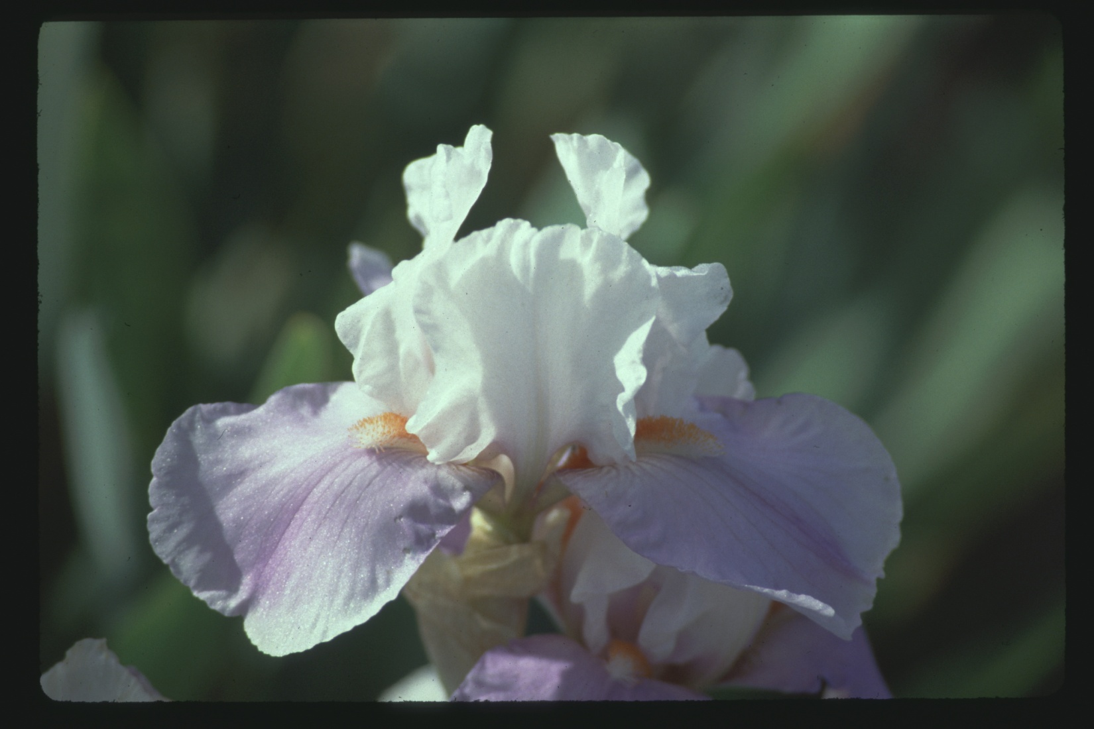
Cool Treat
1994 | BB | 6E+25 | 46-IB Hellcat X TB | HM

Slide 11
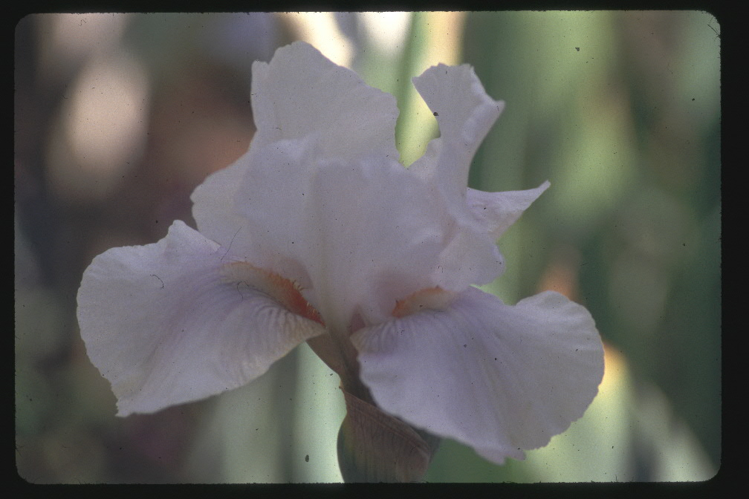
Snoopy
1996 | BB | 7K45 | 47-TB X 6E25-Cool Treat | HM

Slide 12
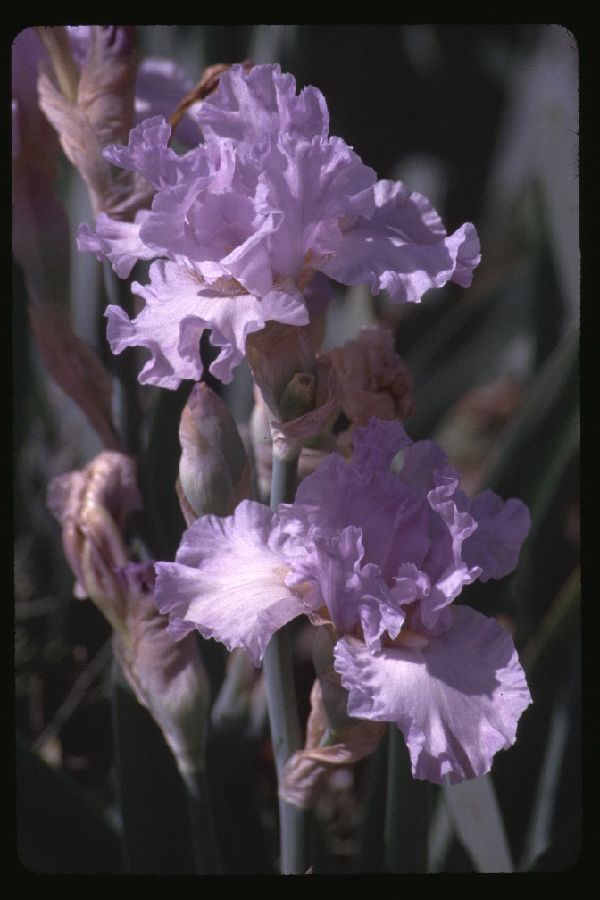
Friday Blues
1997 | BB | 6L62 | 46-IB Friday Harbor-4A40-5 X TB | HM

Slide 13
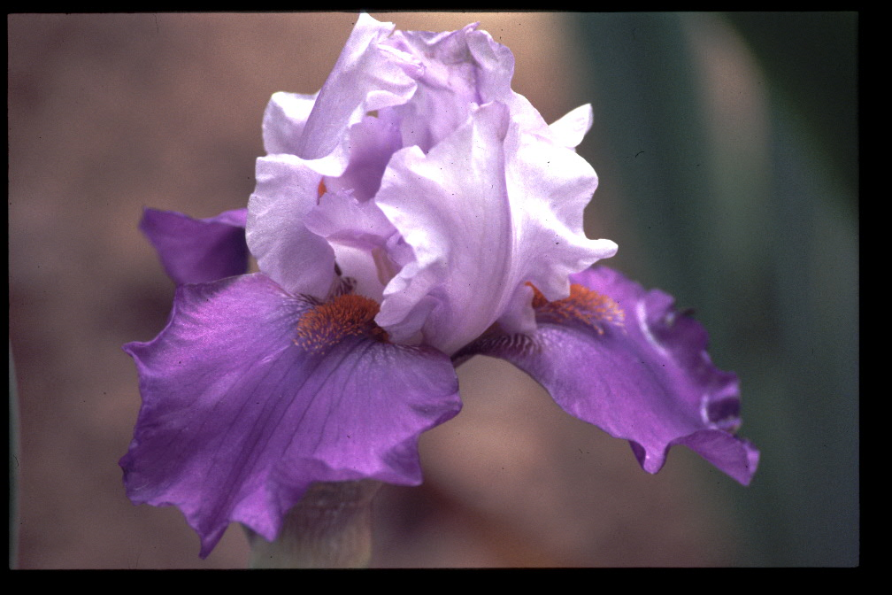
Indigo Doll
1997 | BB | 7L75 | 47-TB X 6E25-Cool Treat | HM

Slide 14
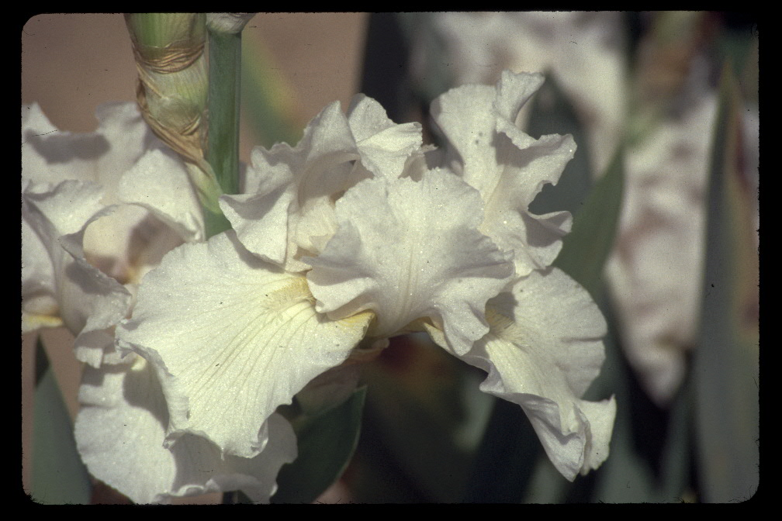
Cotton Charmer
1998 | BB | 7K | 47-Unknown

Slide 15
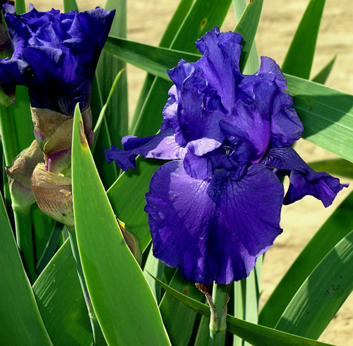
Classic Navy
1999 | BB | 8K51 | 48-TB X TB | AM

Slide 16
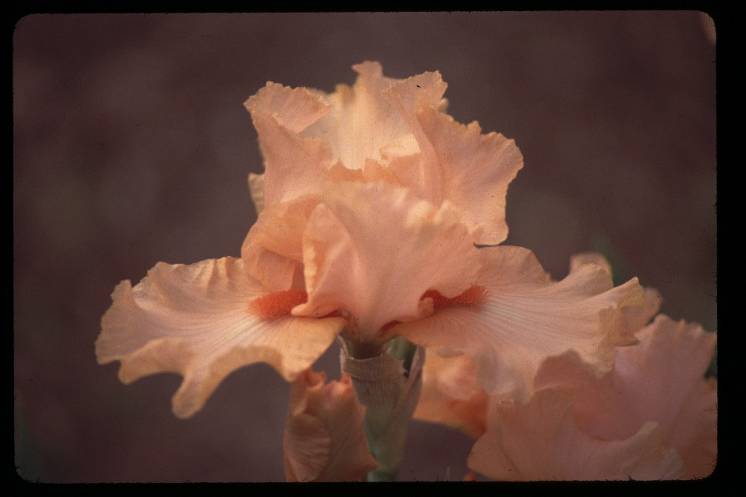
Mango Smoothy
2000 | BB | 5L41 | 45-(IB-Ask Alma x 42 seed) X BB | AM

Slide 17
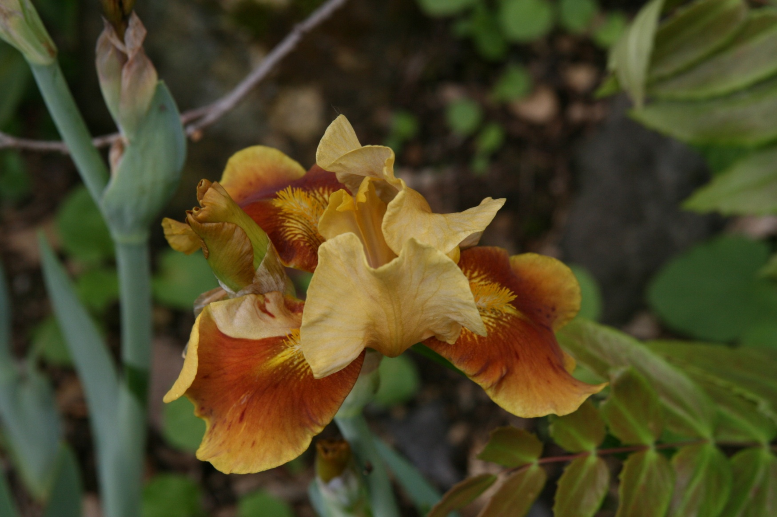
Andi
1974 | IB | L805-1 | 44- TB X SDB | HM

Slide 18
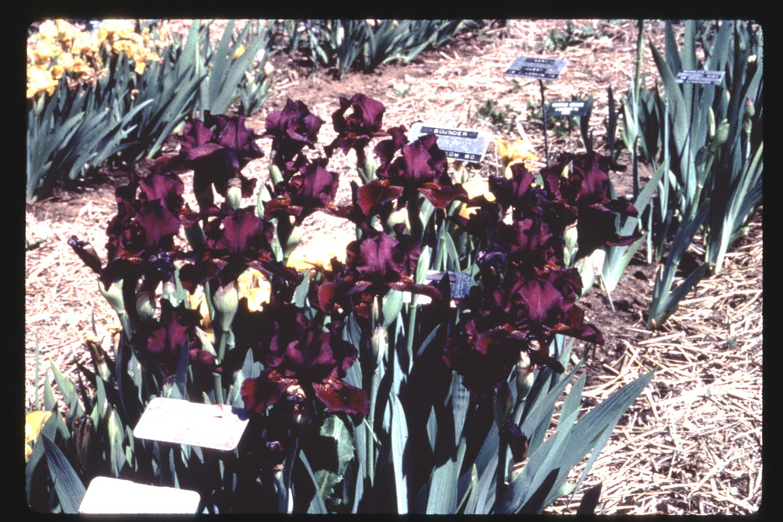
Country Dee Jay
1979 | IB | 7544-1 | 44- Lilliput x Iaphylla Geneva S2 | HM

Slide 19
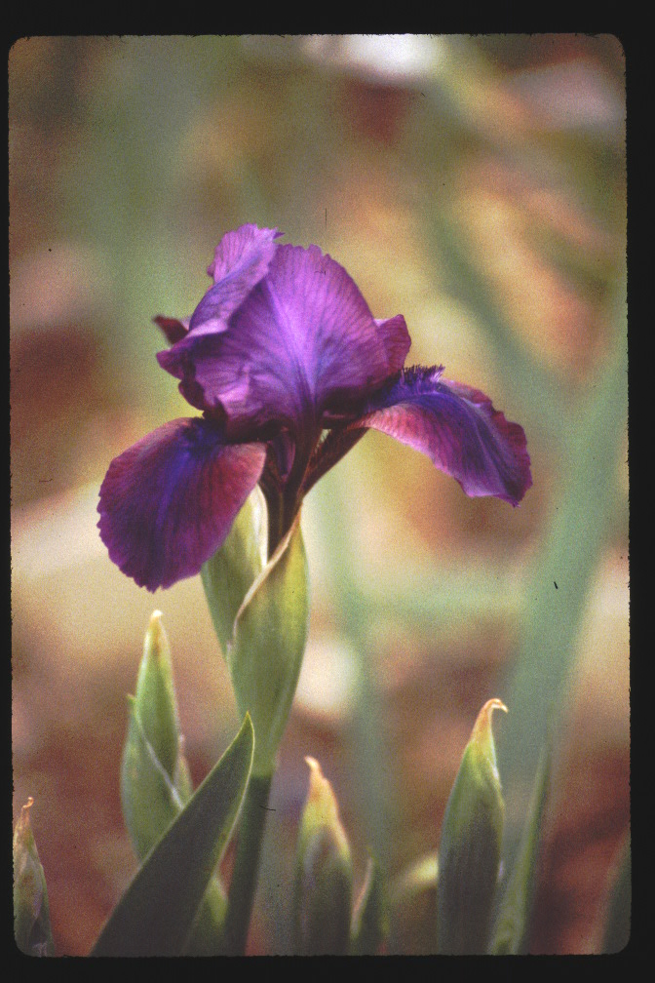
Briquet
1980 | IB | 6622-1 | 44-TB X (TB x Ipumila) | HM

Slide 20
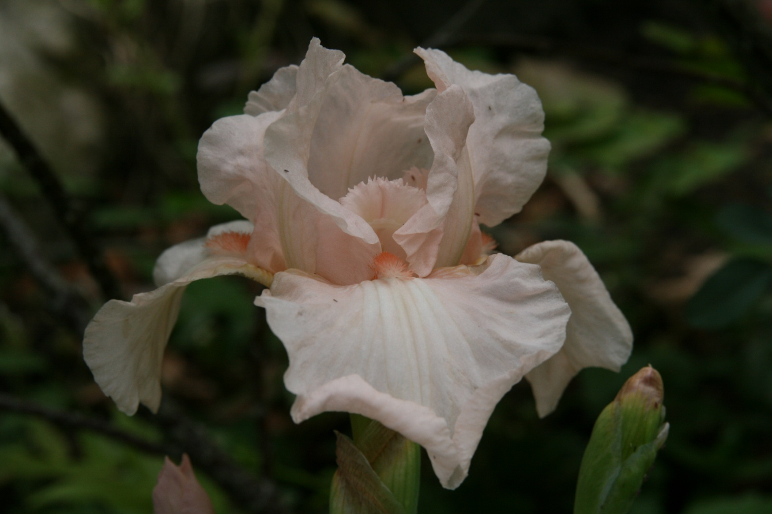
Keri
1980 | IB | 7592-2 | 44-TB X SDB

Slide 21
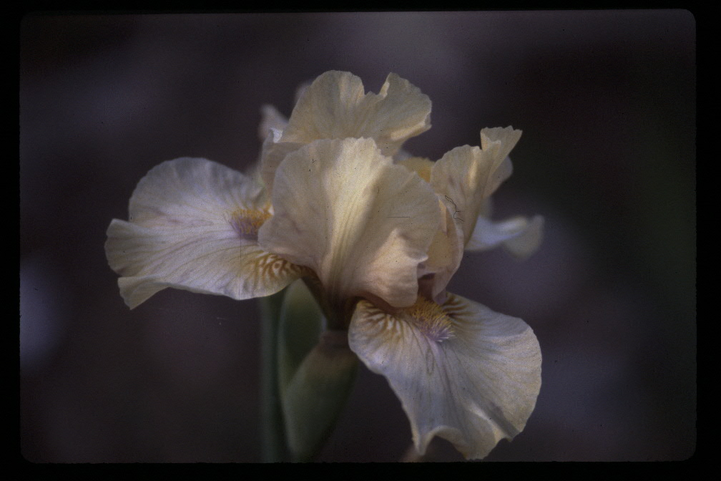
Moss Bay
1986 | IB | 4A39-1 | 44-SDB X Iaphylla-Geneva S2 | HM

Slide 22
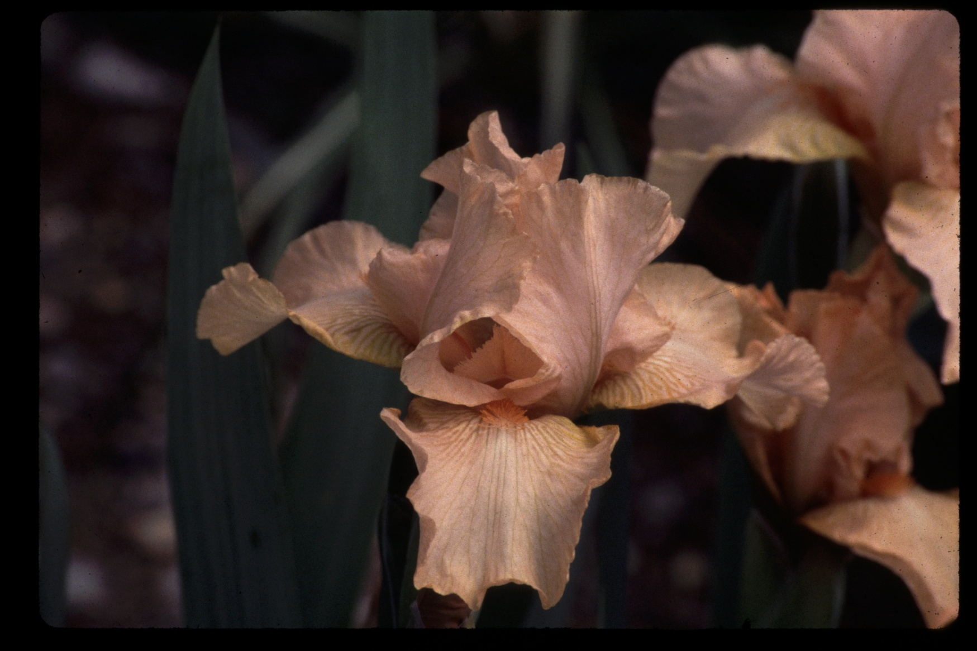
Ask Alma
1987 | IB | 4B-32-7 | 44-TB X SDB | Medal

Slide 23
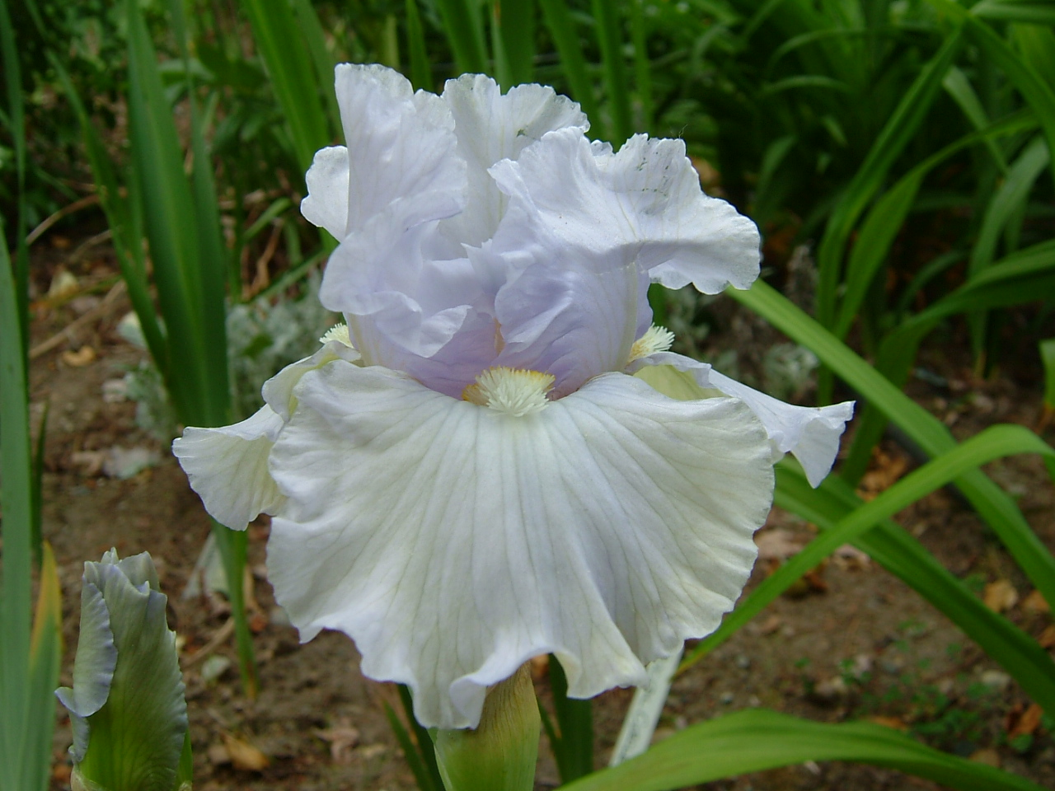
Friday Harbor
1989 | IB | 4A40-5 | 46-SDB X TB | HM

Slide 24
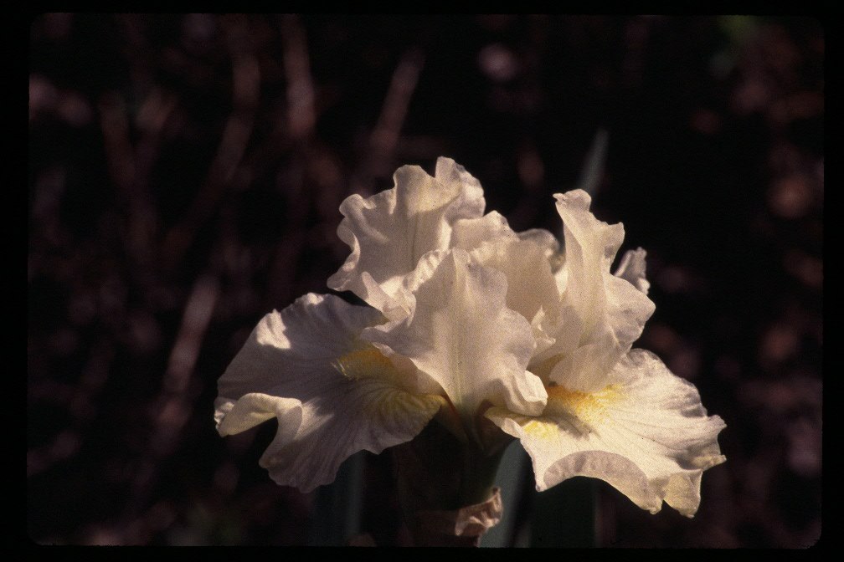
Lady Day
1990 | IB | 4C39-3 | 44-SDB X TB

Slide 25
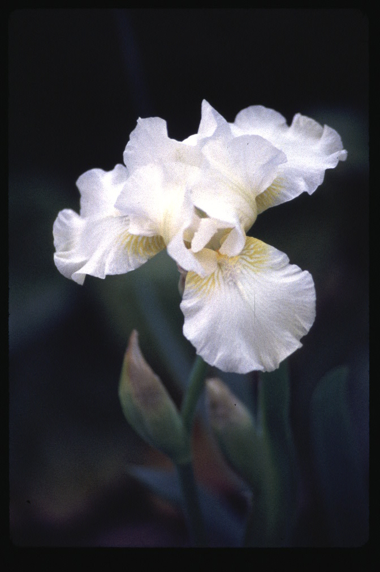
Kara Noelle
1991 | IB | 4F50-3 | 44-TB X SDB

Slide 26
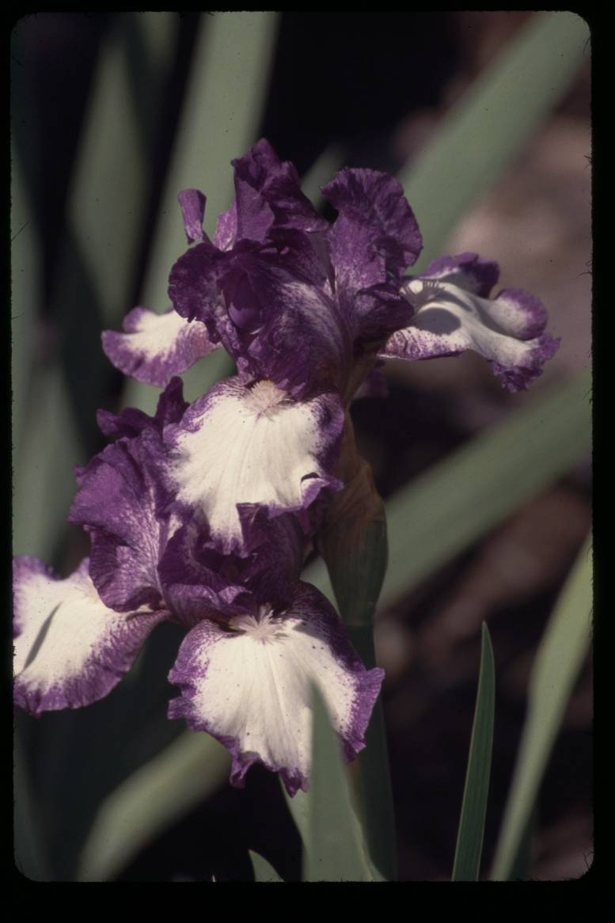
Cee Jay
1992 | IB | 4G35-1 | 44-TB X SDB | Medal

Slide 27
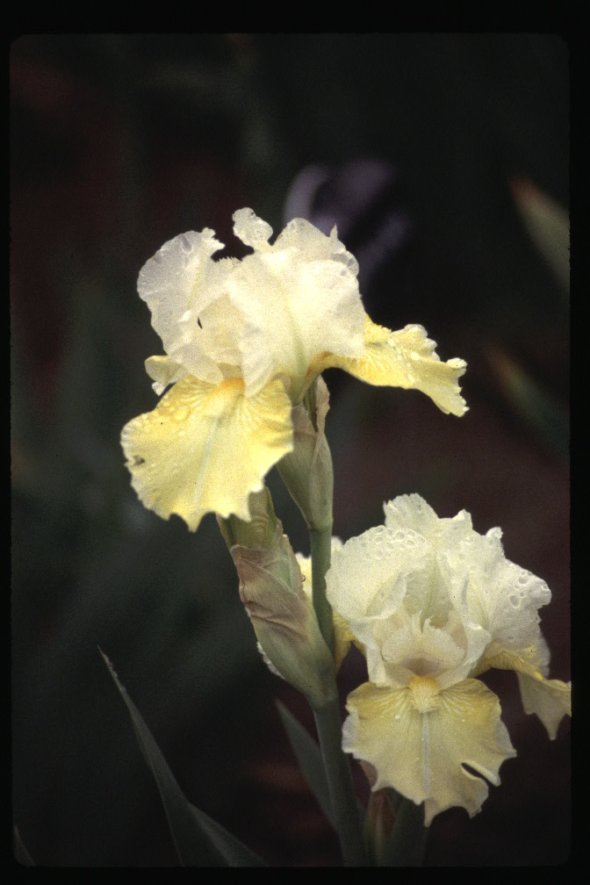
Lemon Whip
1993 | IB | 4H55-1 | 44- TB X SDB | AM

Slide 28
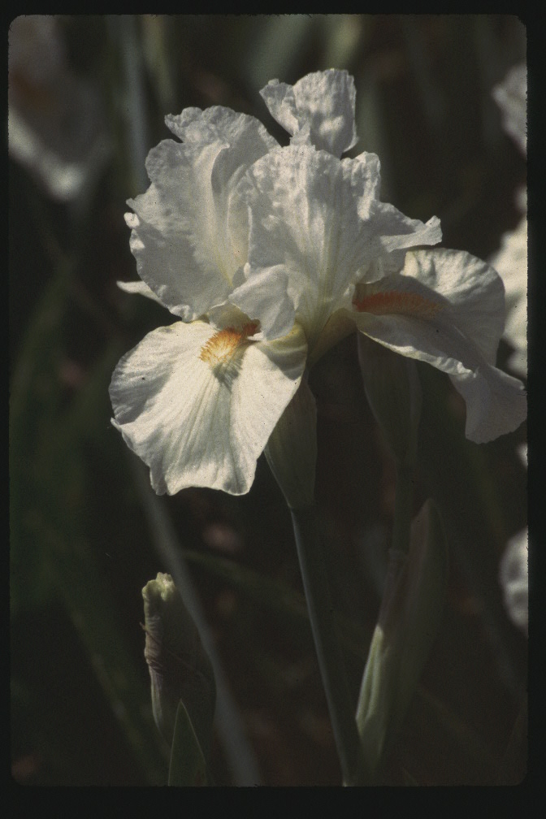
Santas Helper
1997 | IB | 4J34 | 44-(TB X(( IB-Cheers x (TB x SDB))

Slide 29
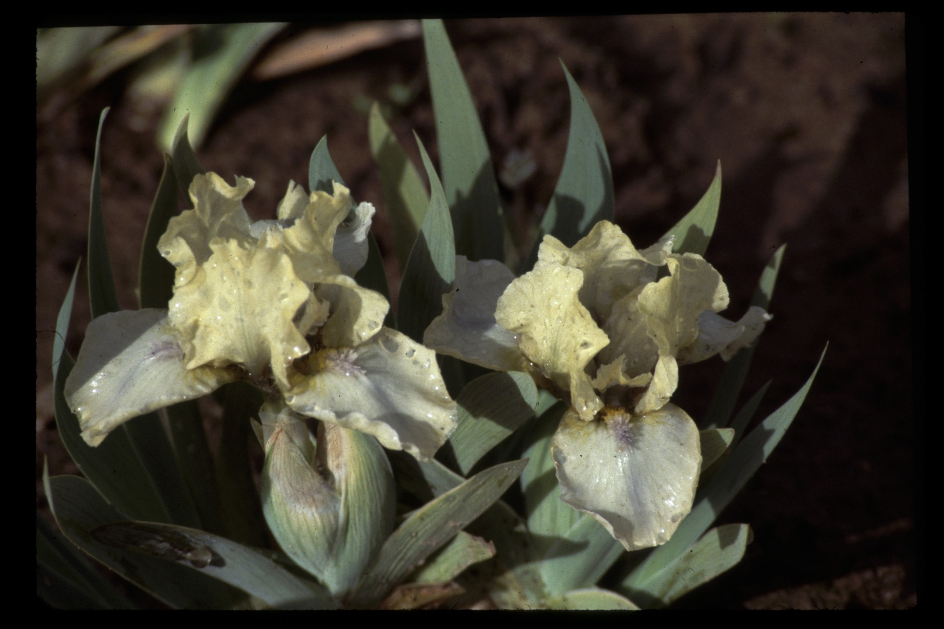
Hey There
1992 | MDB | OH1-1 | 36-SDB X MDB | Medal

Slide 30
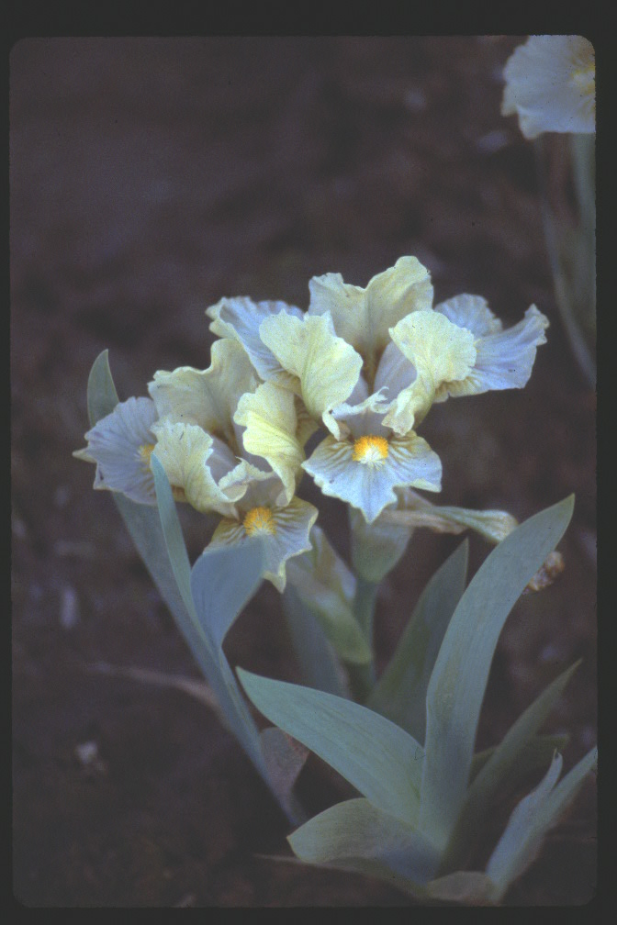
Jolly Joey
1993 | MDB | 0J4-11 | 40-SDB X SDB

Slide 31
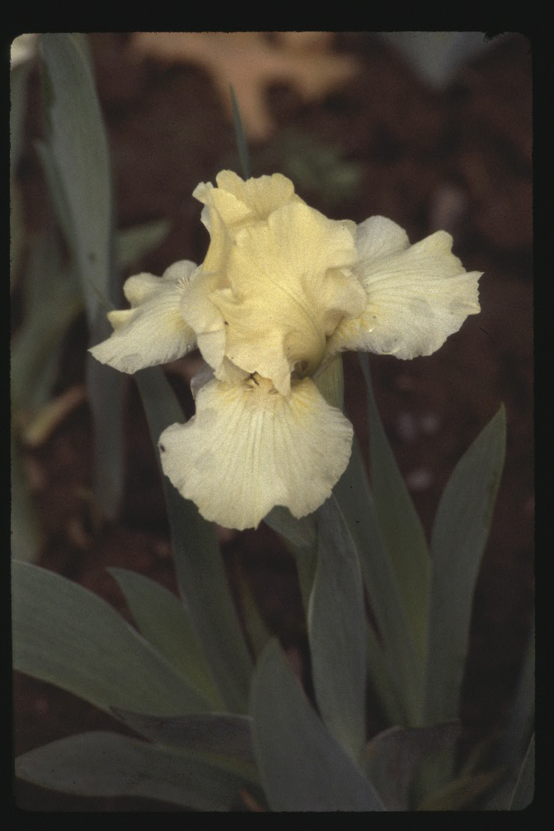
Belle Plaine
1984 | SDB | 80-8-1 | 40-SDB X SDB

Slide 32
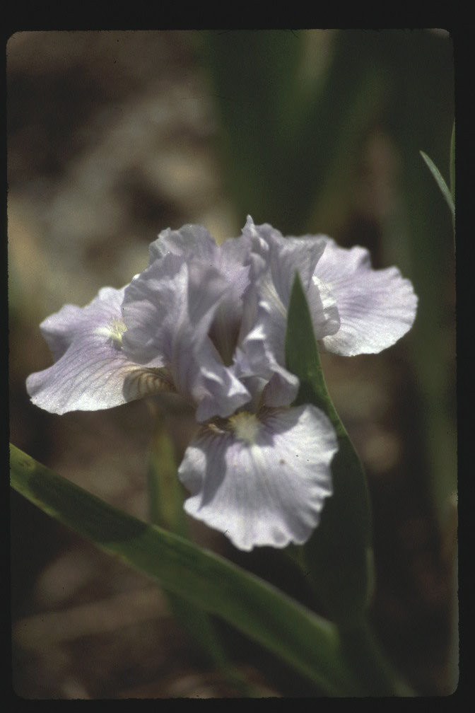
Sea Worthy
1984 | SDB | 80-2-2 | 40-SDB X SDB

Slide 33
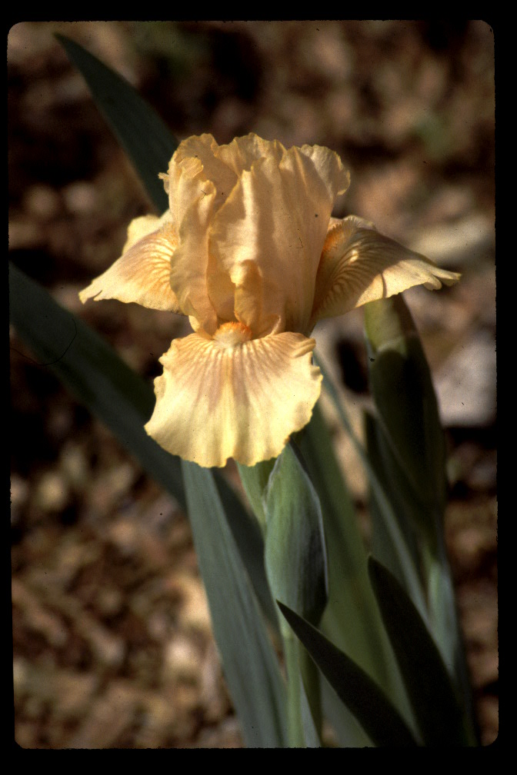
Pipe Stone
1985 | SDB | 80-10-5 | 40-SDB X SDB

Slide 34
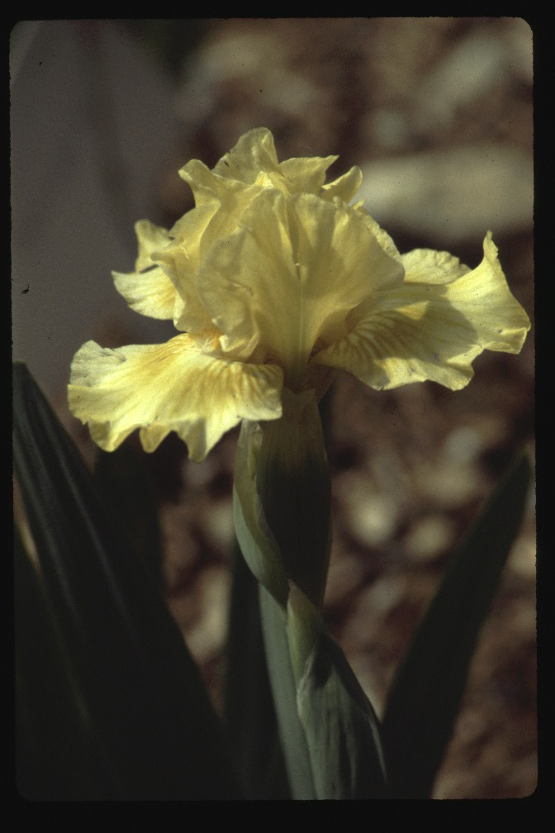
Straw Hat
1985 | SDB | 80-11-3 | 40-SDB X SDB | HM

Slide 35
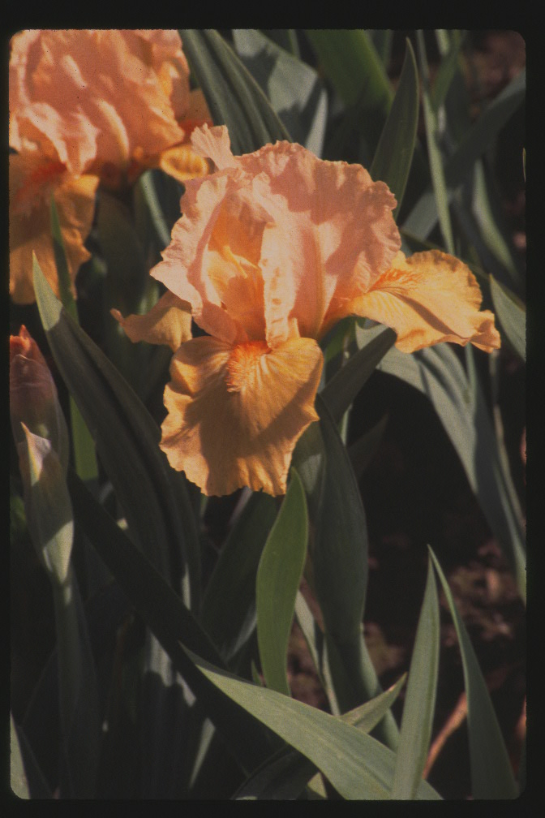
Live Jazz
1986 | SDB | 2A24-3 | 42-IB-Spring Bonnet X SDB-L56 | HM

Slide 36
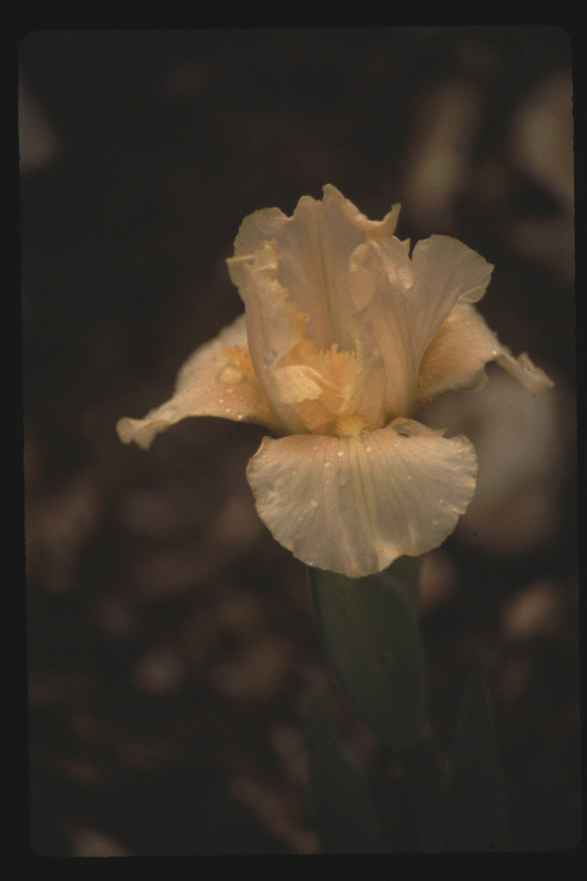
Broad Grin
1987 | SDB | 2A25-2 | 42-(IB Appleblossom Pink X SDB) | HM

Slide 37
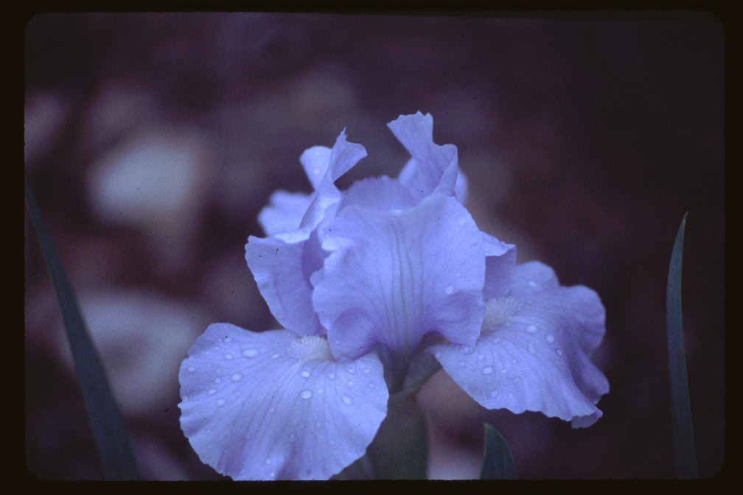
Jesse Lee
1987 | SDB | 0A21-10 | 40-SDB X SDB | HM

Slide 38
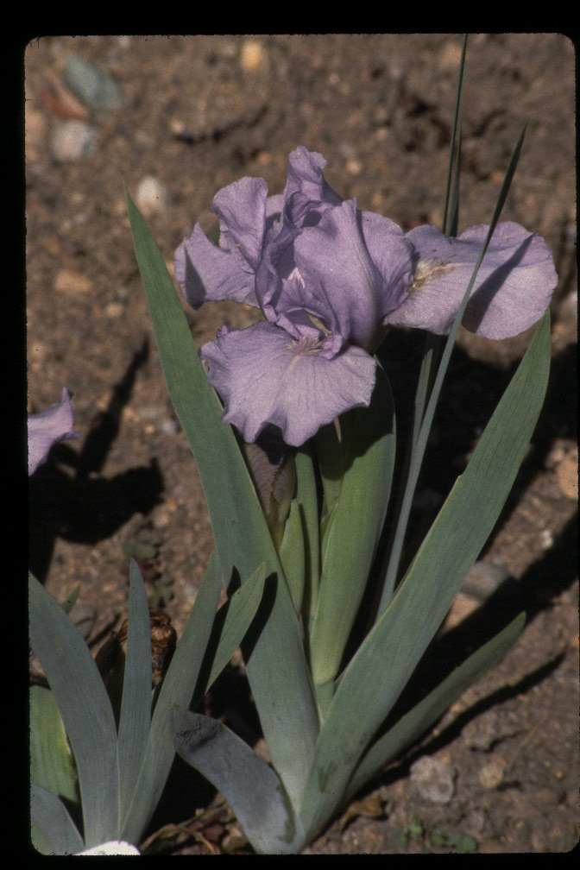
Home Port
1988 | SDB | 0C5-1 | 40-SDB X SDB

Slide 39
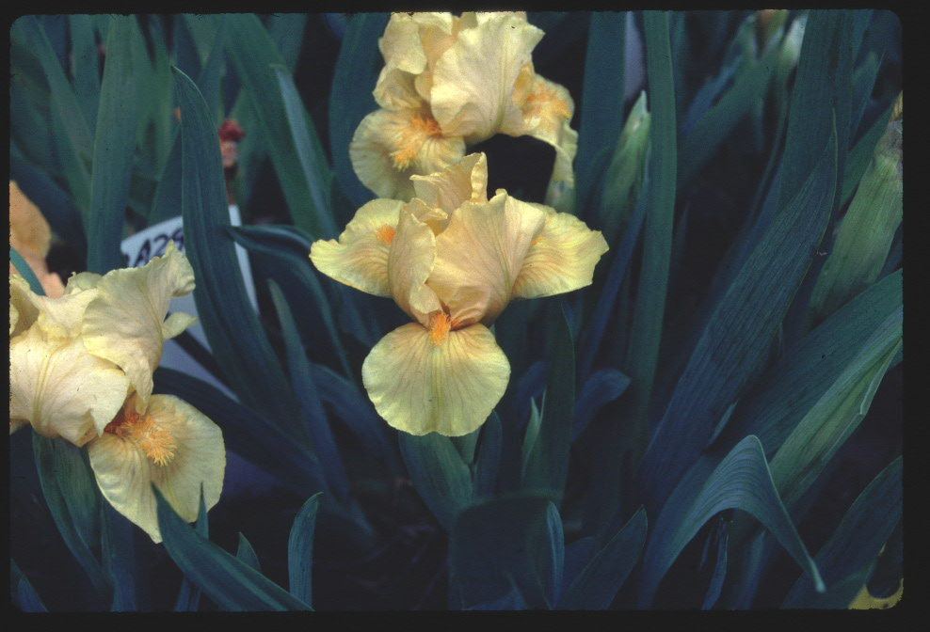
Oh Jay
1988 | SDB | 2A30-4 | 42-SDB X (SDB x TB)

Slide 40
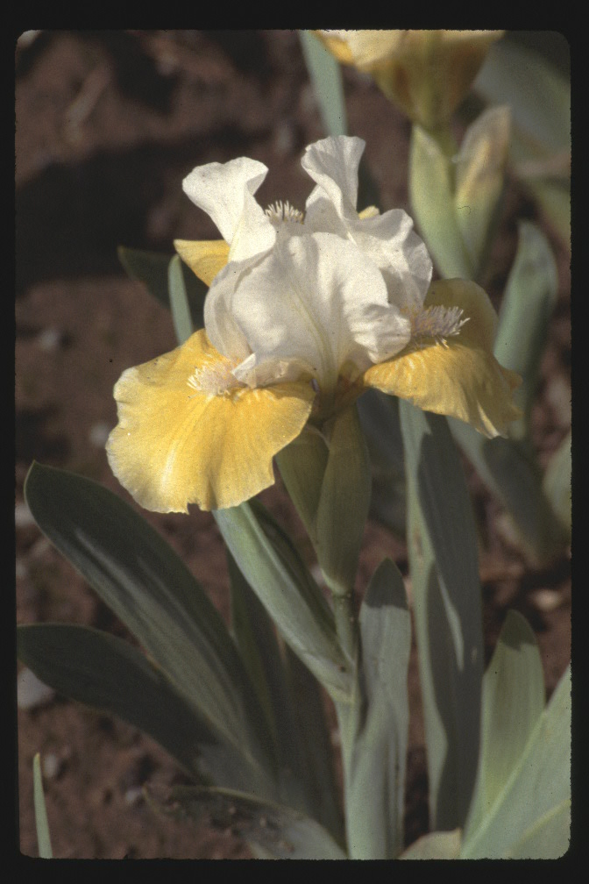
Over Easy
1990 | SDB | 0F6-25 | 40-SDB X SDB | HM

Slide 41
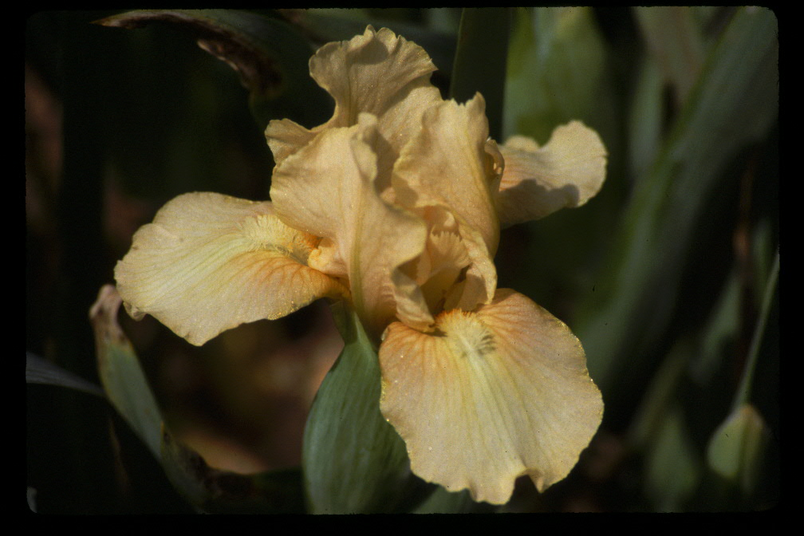
Rosalie M
1990 | SDB | 2F28-5 | 42-(IB-Peachy Face X SDB

Slide 42
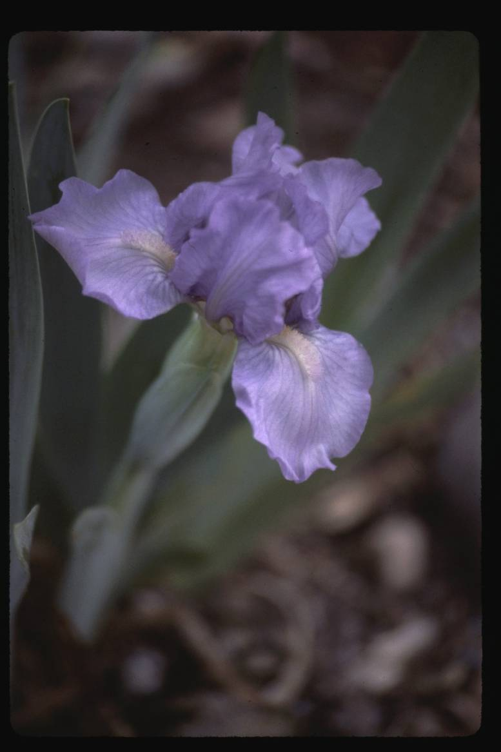
Violet Wood
1990 | SDB | 0C4-4 | 40-SDB X SDB

Slide 43
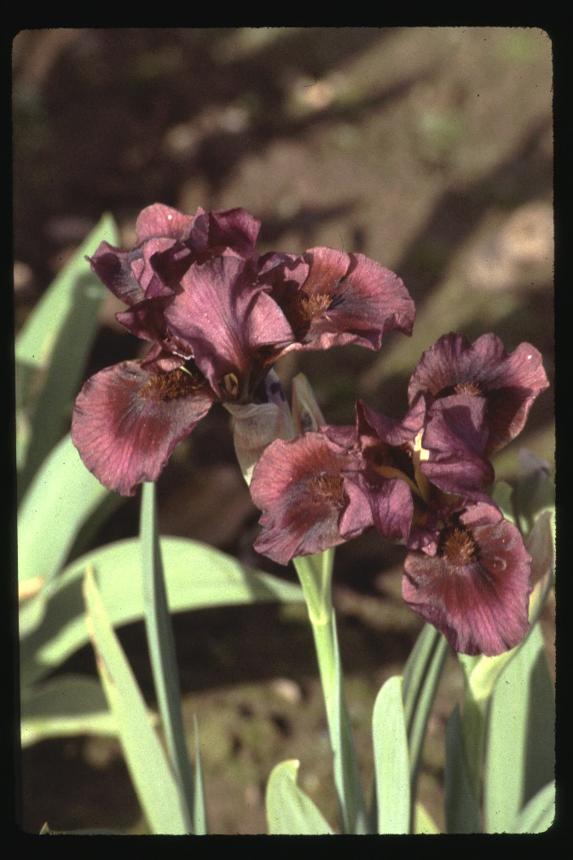
Nut Ruffles
1992 | SDB | 0H15-1 | 40-SDB X SDB | AM

Slide 44
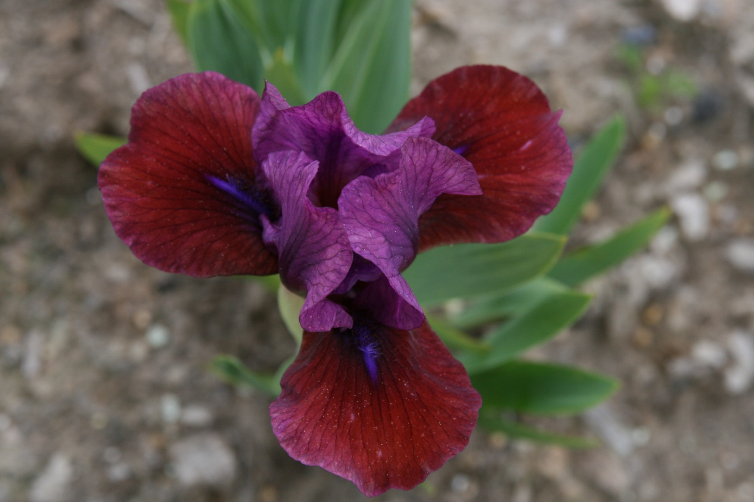
Jewelers Art
1993 | SDB | 0H15-2 | 40-SDB X SDB | AM

Slide 45
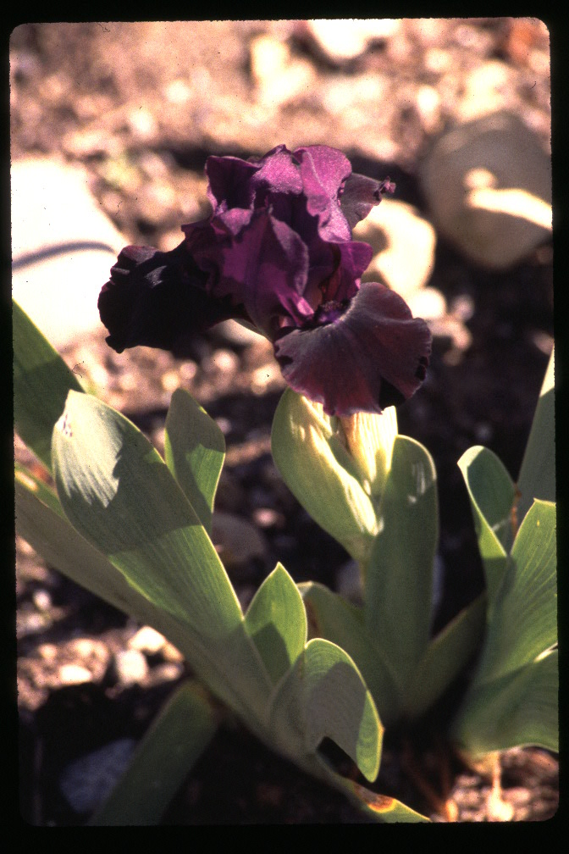
Plum Lucky
1994 | SDB | 0F4-2 | 40-SDB X SDB | HM

Slide 46
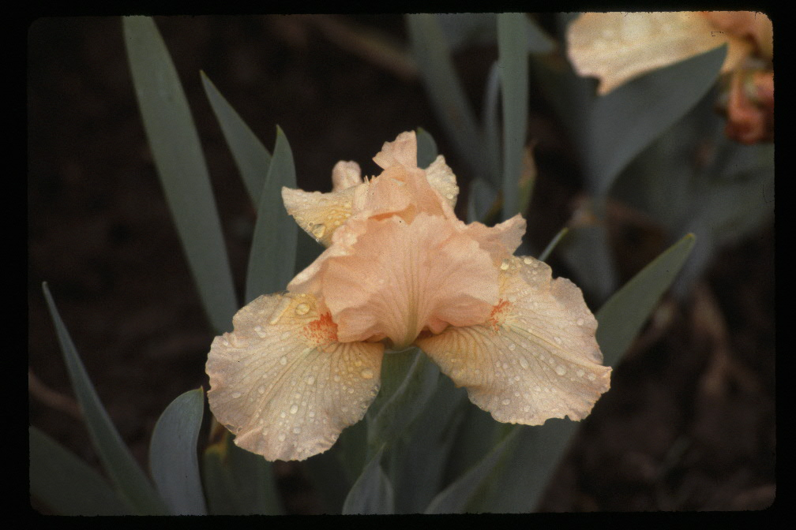
Tickled Peach
1994 | SDB | 2H27-1 | 42-IB-Spring Dancer X SDB | HM

Slide 47
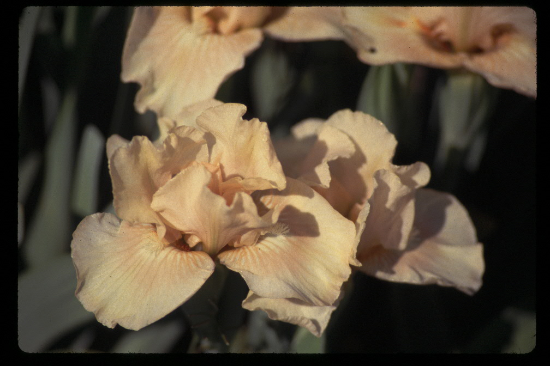
China Peach
1995 | SDB | 1D24-3 | 41-SDB X 2A25-2-Broad Grin | HM

Slide 48
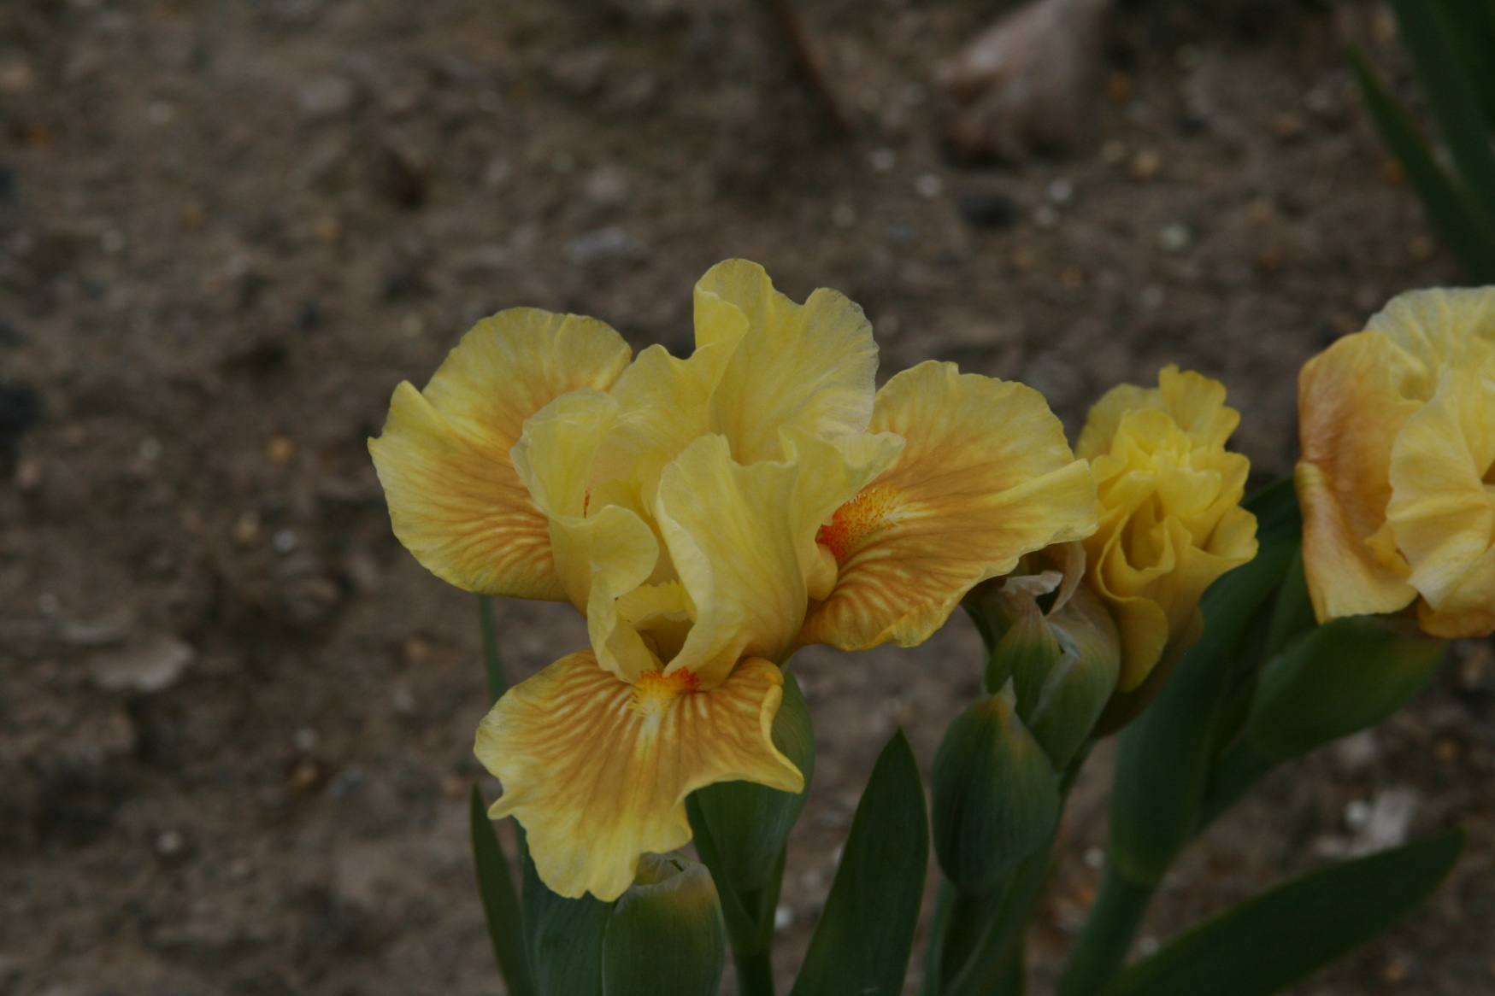
Condensed Version
1999 | SDB | 0L13 | 40-SDB X SBD

Slide 49
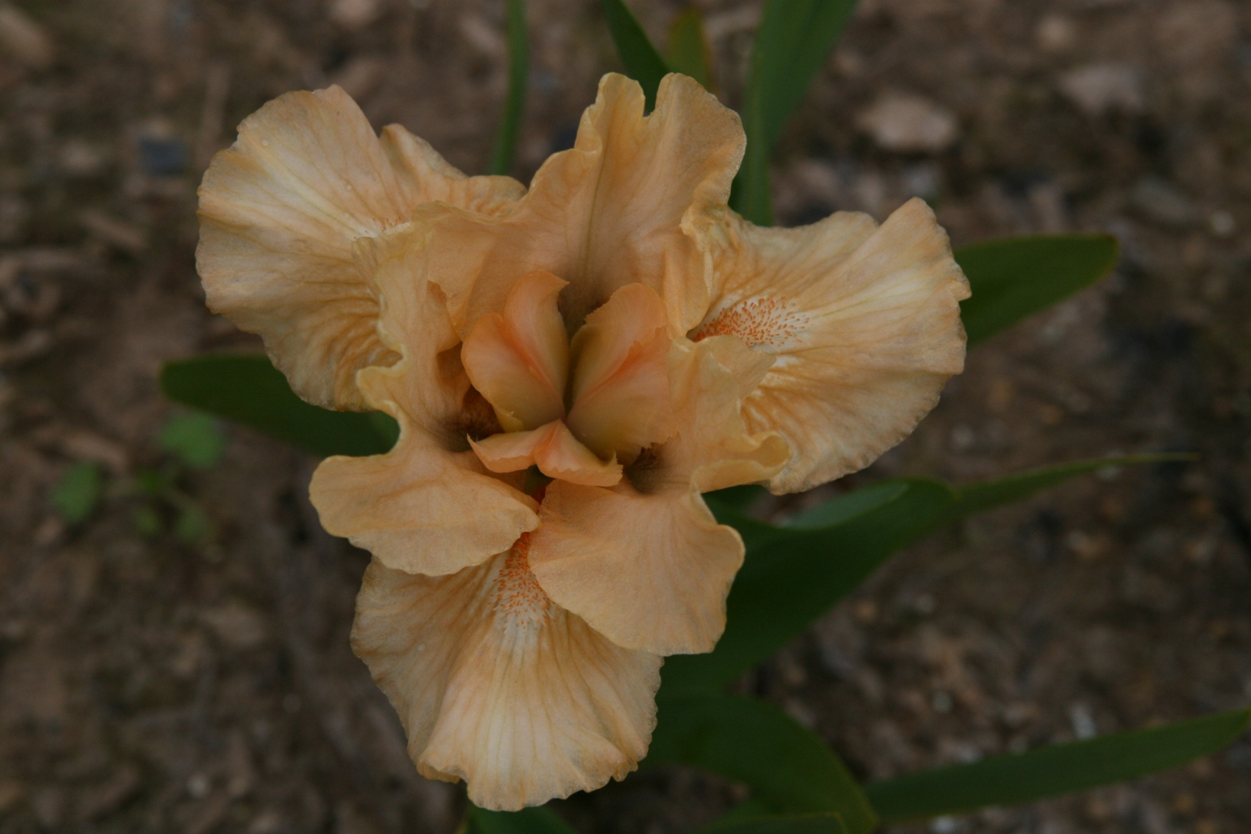
Peach Ruffles
2000 | SDB | 0L1-C | 40-SDB X SDB | HM

Slide 50
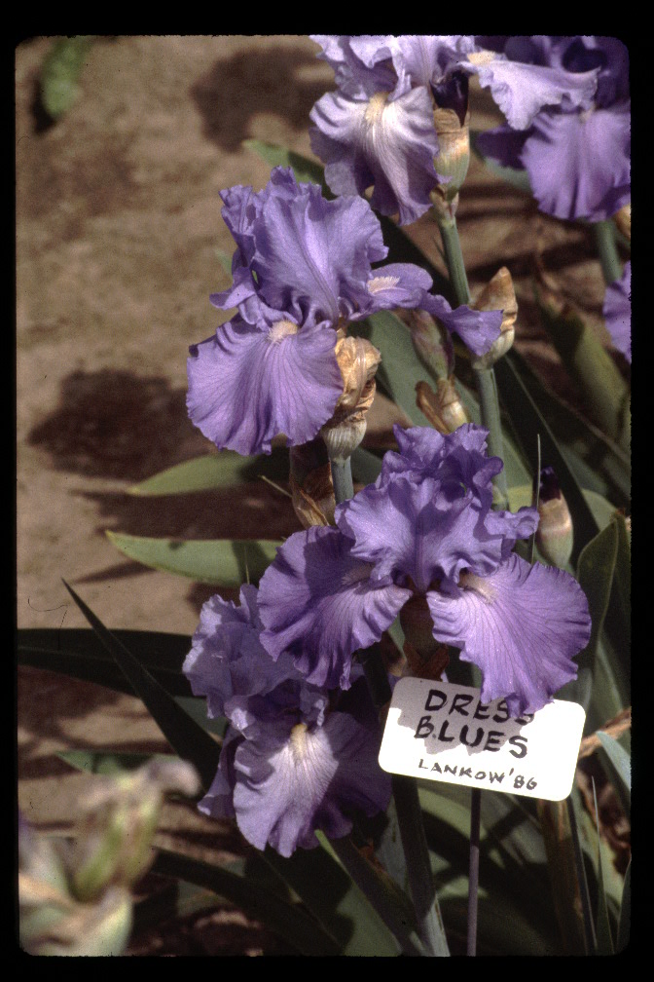
Dress Blues
1986 | TB | 80-20-1 | 48- TB X TB

Slide 51
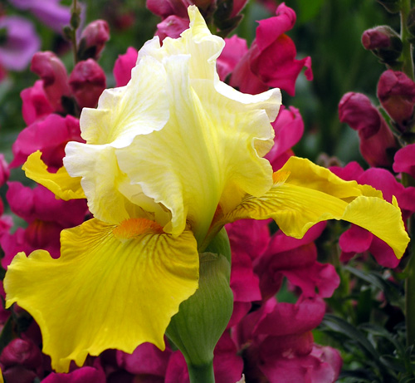
Dancing Sunspots
2001 | TB | 7L78 | 47-TB X ( IB-Marmalade Skies x TB)

Slide 52
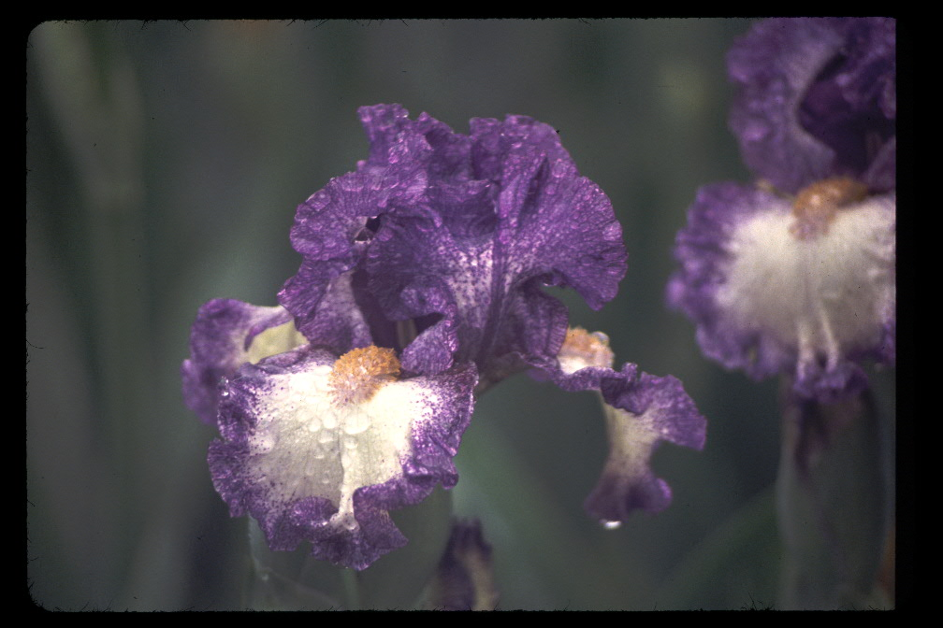
Dotted Ditty
2001 | TB | 6K16 | 46-IB-Cee Jay X TB

Slide 53
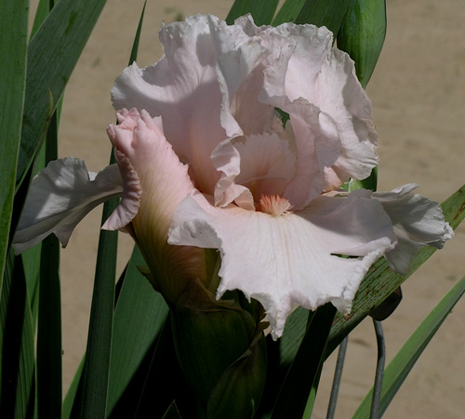
Dream Away
2002 | TB | 7J69 | 47-IB -Looking Good X TB

Slide 54
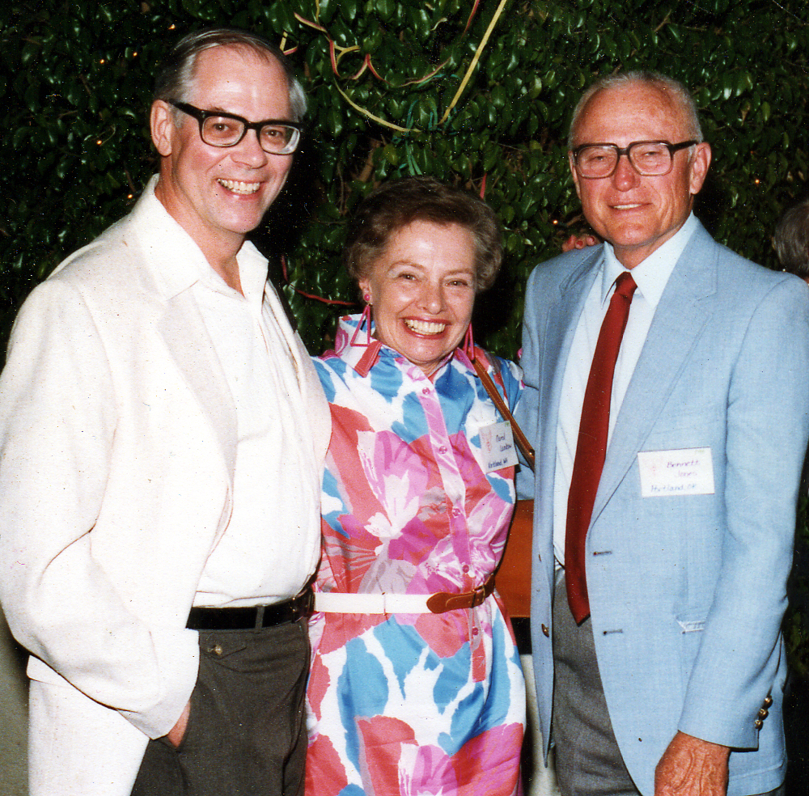
Terry Aitken, Carol Lankow, Bennett Jones
AIS Convention, Phoenix 1987

Slide 55
THE END

